Slide 1

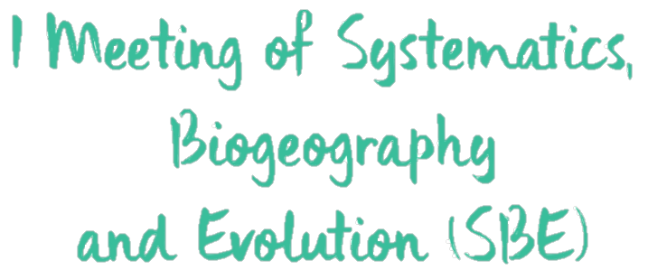

Using deep learning for unifying genomic data and traits in species delimitation
@ManoloFPerez
sites.google.com/site/manolofperez
MF Perez; I Sanmartín; BC Faircloth; LAC Bertollo; MB Cioffi

Slide 2
Introduction
The presence of distinct species concepts leads to different strategies to identify species boundaries (de Queiroz 2007). It is important to adopt a multidisciplinary approach, by integrating different sources of evidence (Carstens et al. 2013).
Most approaches consist in analyzing genetic and phenotypical/geographical information separately, followed by visual/qualitative comparison. Methods that actually integrate different data are limited to up to a few hundreds of loci and simple models of evolution (Solís-Lemus et al. 2015).
We present a method based on simulated data and machine learning, that combines both genomic and trait information in a unified framework.

Slide 3
Methods

Slide 4
Results
Probabilities are low when using only traits.
Increased nº of SNPs also led to a higher probability of recovering the right model.
little improvement with > 50 SNPs.
Using both genomic and trait data recovered slightly better results than using only SNPs.

Slide 5
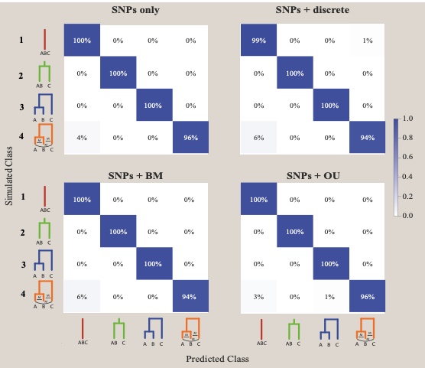
Conclusions
The accuracy of our approach was very high (confusion matrix with the test set). Lowest accuracy between model 4 (migration) with model 1 (one species).
Incorporating traits resulted in similar accuracy to using only SNPs.
Traits incorporate information complementary to genomic data.
The method is flexible, allowing complex scenarios and the use of both types of data.

